Slide 1
Example Assignment Responses
Aguirre
Notes:
Description: This is a title slide.

Slide 2
Setting Up & Accessing StudySync
Completing StudySync Assignments
Example StudySync Assignment Responses

Slide 3
First Day Examples

Slide 4
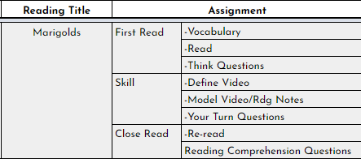
Example Outline of StudySync-Related Assignments
Notes:
Description: This is an announcement slide.

Slide 5
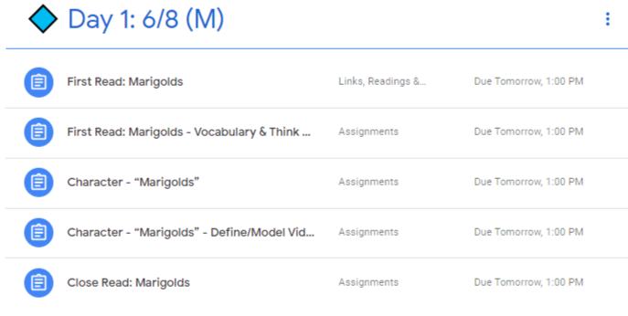
StudySync-Related Assignments As They Appear in Google Classroom
Notes:
Description: This is an announcement slide.

Slide 6
First Read: Marigolds: Vocabulary Examples
Excellent
Average +
Average -
Notes:
Description: This is an announcement slide.

Slide 7
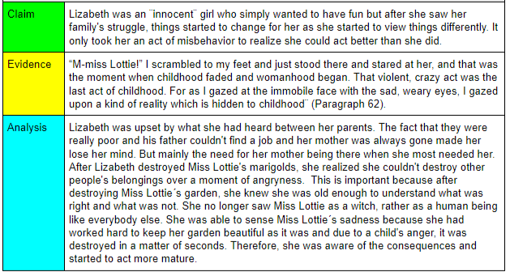
First Read: Marigolds: Think Questions Examples: Excellent
Notes:
Description: This is an announcement slide.

Slide 8
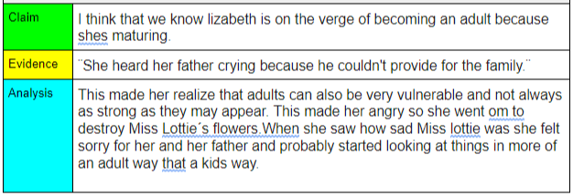
First Read: Marigolds: Think Questions Examples: Average +
Notes:
Description: This is an announcement slide.

Slide 9
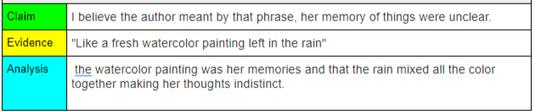
First Read: Marigolds: Think Questions Examples: Average -
Notes:
Description: This is an announcement slide.

Slide 10
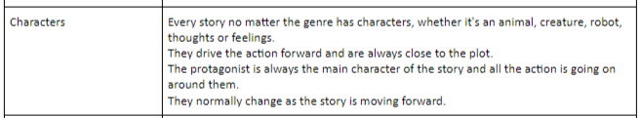
Character - “Marigolds” - Define/Model Video & Reading Notes Examples
Excellent
Average +
Average -
Notes:
Description: This is an announcement slide.

